Slide 1
Course Code:CSC402A Course Title: Web Architecture and Application Development
Course Leader:
Kishore S.M.
kishore.cs.et@msruas.ac.in

Slide 2
Objectives
After completing this lecture, the student will be able to
Analyze data centric architecture
Describe benefits of data centric architectures

Slide 3
Contents
Data centric architecture
Blackboard Architecture Style
Repository Architecture Style

Slide 4
Data Centric Architectures
Data-centered software architecture is characterized by a centralized data store that is shared by all surrounding software components
The software system is decomposed into two major partitions: data store and independent software component or agents
There are two categories of data-centered architecture: repository and blackboard
Repository: The data store in the repository architecture is passive, and clients of the data store are active
The repository style is widely used in database management systems, library information systems, the interface repository (IR) in CORBA, the UDDI registry for web services, compilers, and Computer Aided Software Engineering (CASE) environments

Slide 5
Data Centric Architectures
Blackboard: The data store in the blackboard architecture option is active, and its clients are passive and thus, the flow of logic is determined by the current data status in the data store
The clients of a blackboard are called knowledge sources, listeners, or subscribers. A new data change may trigger events so that the knowledge sources take actions to respond to these events. These actions may result in new data, which may in turn change the logic flow this could happen continuously until a goal is reached
Many applications designed in the blackboard architecture include knowledge-based AI systems, voice and image recognition systems, security systems, business resource management systems, etc

Slide 6
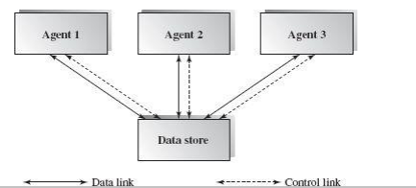
Data Centric Architectures

Slide 7
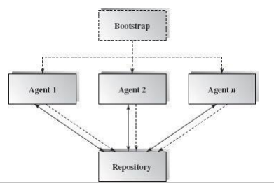
Data Centric Architectures
Repository Architecture Style: The repository architecture style is a data-centered architecture that supports user interaction for data processing.
General picture of the Repository Architecture

Slide 8
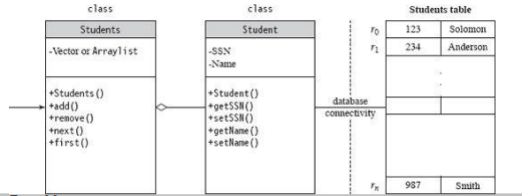
Data Centric Architectures
Class diagram for a simple data store for student management

Slide 9
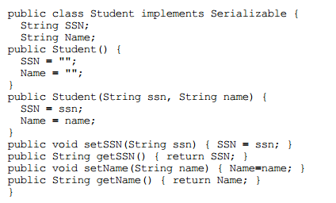
Data Centric Architectures
Java code for the class diagram

Slide 10
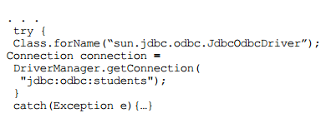
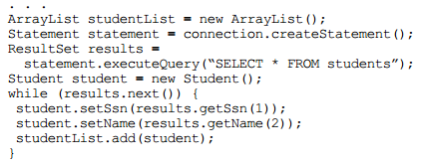
Data Centric Architectures
Java database connectivity

Slide 11
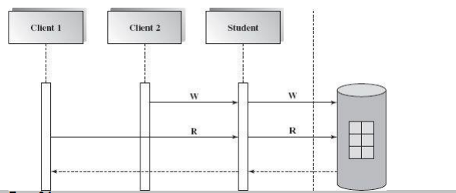
Data Centric Architectures
The relational database management system is a typical design domain for the repository architecture
The data store of the repository maintains all types of data including schema (metadata), data tables, and index files for data tables
The below figure shows a typical database system with its data repository

Slide 12
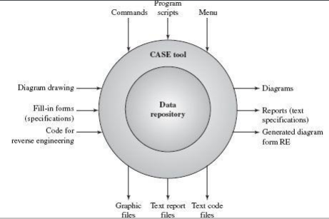
Data Centric Architectures
A Computer Aided Software Engineering (CASE) system is another popular application domain for the repository software architecture
A user of CASE tools can draw a UML design diagram such as a class diagram, collaboration diagram, or sequence diagram by Booch method, Rumbaugh method, or Jacobson method, and store the design blueprints in the CASE data store

Slide 13
Data Centric Architectures
Benefits:
• Data integrity: easy to back up and restore
• System scalability and reusability of agents: easy to add new software components because they do not have direct communication with each other
• Reduces the overhead of transient data between software components

Slide 14
Data Centric Architectures
Limitations:
• Data store reliability and availability are important issues. Centralized repository is vulnerable to failure compared to distributed repository with data replication
• High dependency between data structure of data store and its agents. Changes in data structure have significant impacts on its agents. Data evolution is more difficult and expensive
• Cost of moving data on network if data is distributed

Slide 15
Data Centric Architectures
Blackboard Architecture Style
The blackboard architecture was developed for speech recognition applications in the 1970s
The word blackboard comes from classroom teaching and learning. Teachers and students can share data in solving classroom problems via a blackboard
Students and teachers play the role of agents to contribute to the problem solving. They can all work in parallel, and independently, trying to find the best solution

Slide 16
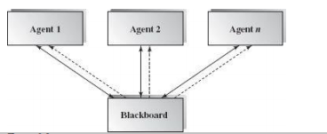
Data Centric Architectures
The entire system is decomposed into two major partitions
Blackboard: is used to store data (hypotheses and facts)
Knowledge Sources: stores domain specific knowledge
There also may be a third partition, called the controller, that is used to initiate the blackboard and knowledge sources and that takes a bootstrap role and overall supervision control.

Slide 17
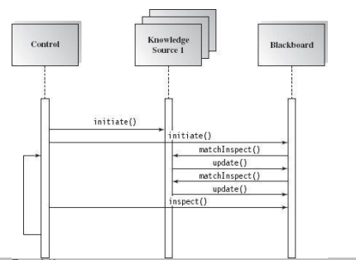
Data Centric Architectures
Publish/Subscribe relationship between the blackboard and the knowledge sources in the blackboard system

Slide 18
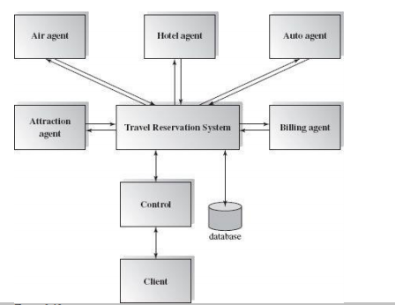
Data Centric Architectures
Travel Consulting System

Slide 19
Data Centric Architectures
Benefits:
• Scalability: easy to add or update knowledge source.
• Concurrency: all knowledge sources can work in parallel since they are independent of each other.
• Supports experimentation for hypotheses.
• Reusability of knowledge source agents.

Slide 20
Data Centric Architectures
Limitations:
• Due to the close dependency between the blackboard and knowledge source, the structure change of the blackboard may have a significant impact on all of its agents
• Since only partial or approximate solutions are expected, it can be difficult to decide when to terminate reasoning
• Synchronization of multiple agents is an issue. Since multiple agents are working and updating the shared data in the blackboard simultaneously, the preference or priority of executions of multiple agents must be coordinated.
• Debugging and testing of the system is a challenge.

Slide 21
Summary
Data-centered software architecture is characterized by a centralized data store that is shared by all surrounding software components
The blackboard architecture was developed for speech recognition applications in the 1970s

